Slide 1
Notes:
From here, I’d like to spend a little bit of time taking a deeper dive into 2 areas that are probably the most pertinent to APX’s wheelhouse.
First I would like to talk about how game designers typically approach creating the UI or HUD. There is a widely accepted design language and methodology used in the gaming world for managing the display of data in a virtual space which I think might be educational.
Second, I’d like to talk about how we manage the flow of data to our users. Our products are frequently a pretty complicated system of interactions, visual cues, and data and we have a few tricks up our sleeves for training our users about those complexities without disengaging them. In fact, we usually make the experience pretty fun!

Slide 2
Notes:
Back in 2009, two students, working in conjunction with EA’s Dice studio (the makers of the Battlefield FPS game series) came out with a Master of Science Thesis called “Beyond the HUD: User Interfaces for Increased Player Immersion in FPS Games”.
In the paper, the pair effectively demonstrated how User Interfaces can be distilled down to several planes of existence inside the game space of a first person shooter and then how knowledge of this breakdown could be used to make a more targeted and engaging experience.
Before I begin, there are two basic concepts you need to understand when we talk about this theory: narrative and the fourth wall.

Slide 3
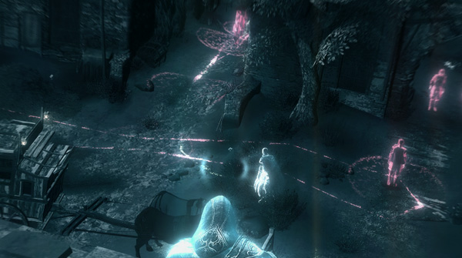
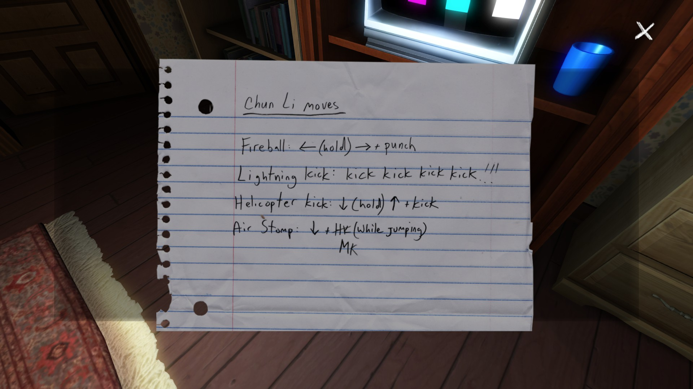
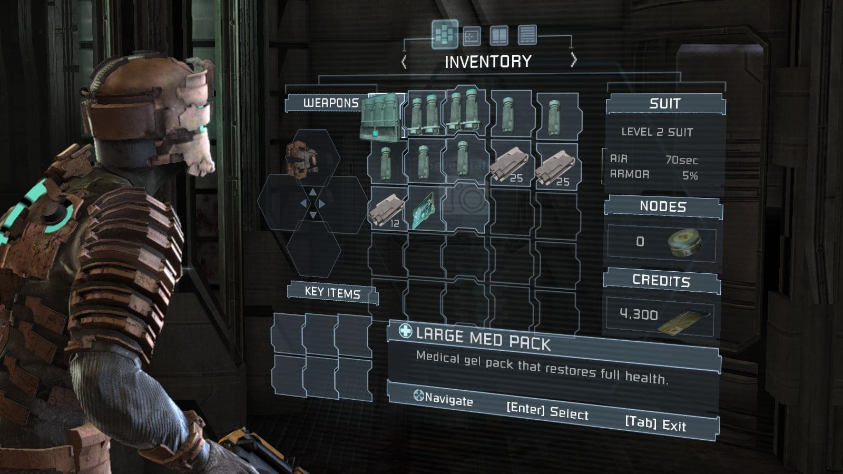
Narrative
Notes:
In simple terms, narrative is anything that helps set the stage, mood, backstory, or environment surrounding a player’s virtual avatar in a game.
This can be anything from:
the audio track of the game,
to footprints on the ground,
to dropped papers in the game world with notes telling backstory,
or even themed elements on a HUD.

Slide 4
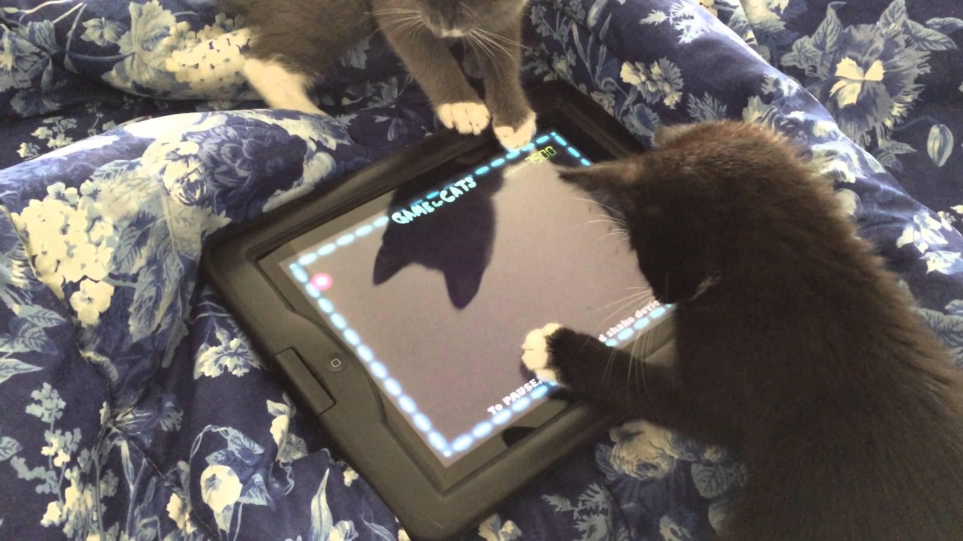
The Fourth Wall
Notes:
The fourth wall is a movie/stage term which is basically the imaginary divide between the audience (or player) and the movie, stage, or game world. In gaming terms, this is simply the screen on your monitor or television set.
In any of the approaches I’m about to describe, the goal is to get the player immersed in your game.
You want them to forget about this fourth wall and experience you narrative while still providing them with all the tools and functionality they need via your user interface to properly navigate the game world.
You want an immersive, but not functionally frustrating user experience.

Slide 5
Designing for Immersion
Is the component part of the game story/narrative?
Is the component part of the game space? Or is it in front of the 4th wall?
Notes:
So, understanding these basic principles, when designing for immersion in a virtual experience, the designer merely has to ask 2 questions about their UI:
Is the component part of the game story/narrative?
Is the component part of the game space? Or is it in front of the 4th wall with the player?

Slide 6
Notes:
Depending on the answer to these questions, you can classify any UI component into one of four classes: diegetic, non-diagetic, spatial, or meta.

Slide 7
Notes:
For diegetic components, we answer our two questions as follows:
Is the interface component in the game story? YES
Is the component in the game space? YES

Slide 8
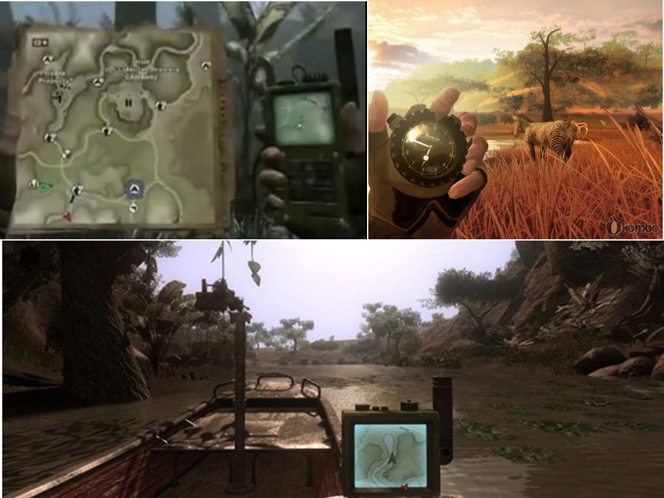
Notes:
Some games, like Far Cry 2 take the approach of using entirely diegetic elements.
There is no HUD. The game makes use of extensive in-game gadgets and items to get information to the user about their surroundings. There are no artificial elements superimposed on the user’s “vision”.

Slide 9
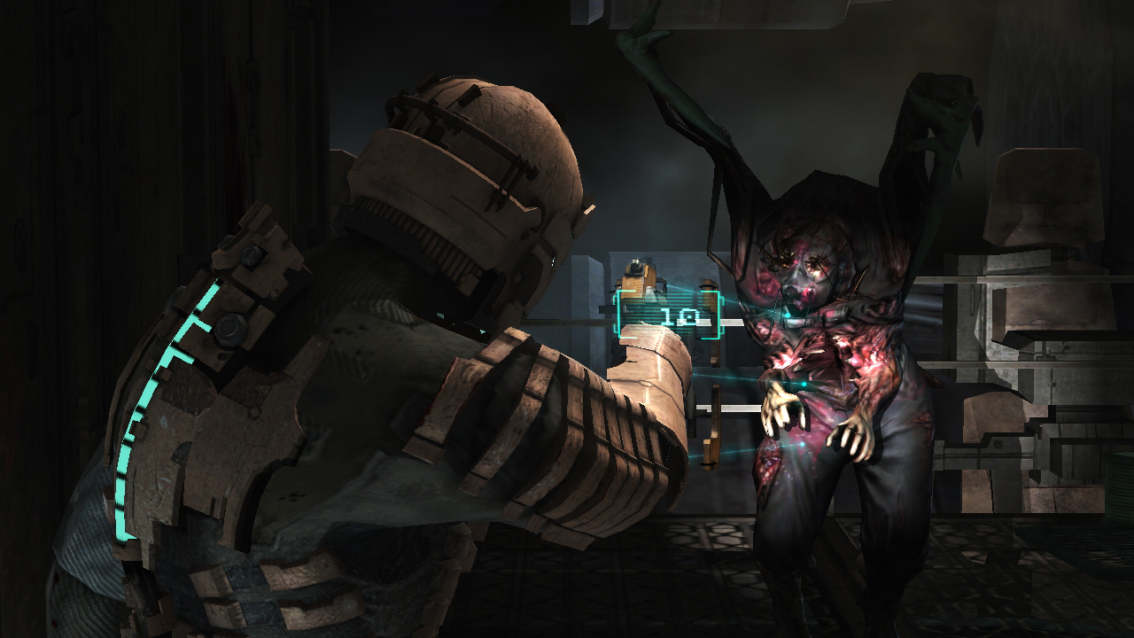
Notes:
Deadspace is another game that makes extensive use of a Diegetic approach to the user interface (albeit from a third-person perspective)
In AR terms, you can think of a diegetic element as anything in the real world which conveys information to a person, like a mobile phone, a digital wristwatch, or even a newspaper.

Slide 10
Diegetic
Strengths
Weakness
Creating Immersion
Focusing on specific tasks without distraction
Natural story telling
Displaying lots of categorical information
Often time-consuming and resource heavy to implement
Can be painful for user to rapidly access information on the fly
Notes:
Creating Immersion. If you want someone focused on a task without distractions, try and create diegetic elements. They are also great for telling story in a very natural way.
They are not so good at displaying lots of categorical or complicated data sets in an easy to access, rapid-fire way.

Slide 11
Notes:
Non-Diegetic

Slide 12
Notes:
For non-diegetic components, we answer our two questions as follows:
Is the interface component in the game story? NO
Is the component in the game space? NO

Slide 13
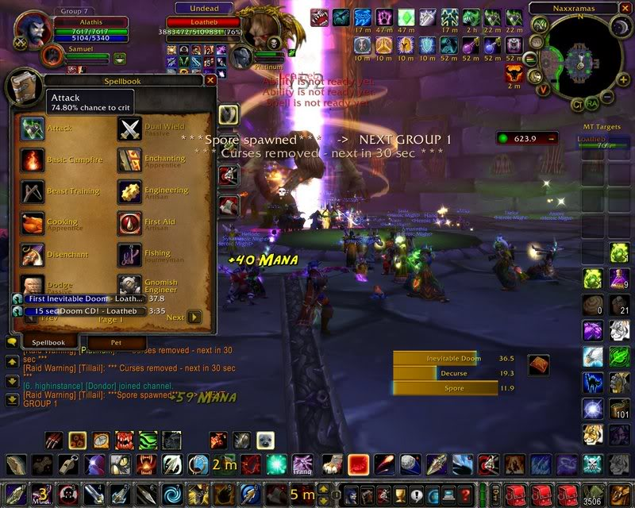
Notes:
A non-diegetic element exists outside the narrative and in front of the 4th wall with the user.
There are many examples of non-diegetic elements in games.
They are usually flat, 2D elements projected in screen space in front of the game world.
They are also typically stylized in a slightly different way from the game world so that they do not get lost.
World of Warcraft’s UI is a great example of a non-diegetic HUD.

Slide 14
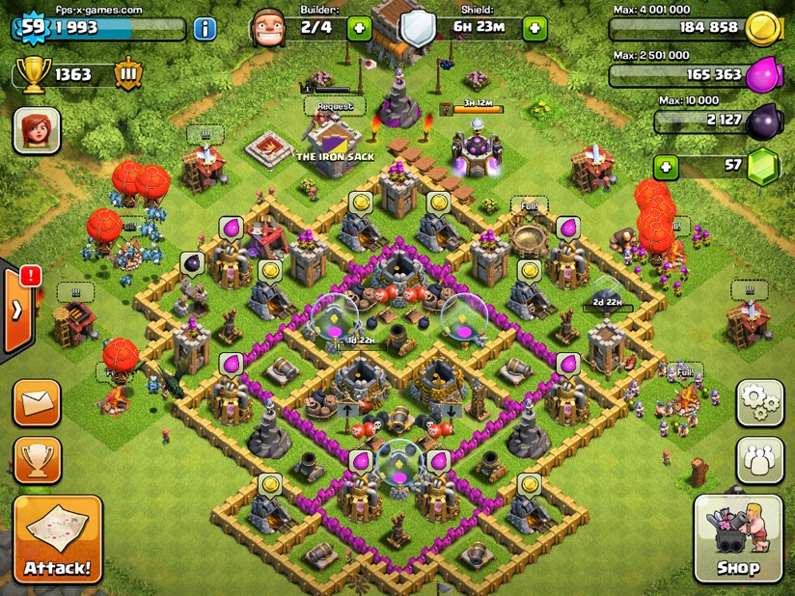
Notes:
As are countless mobile titles like this example from Clash of Clans

Slide 15
Non-Diegetic
Strengths
Weakness
Displaying lots of information to the user
Allows for speed and quick access of information
Can have abstracted informational display
Breaks your focus from the task at hand / narrative or game world
Can get in the way / obstruct critical game events or objects in the scene
Notes:
Displaying a ton of information to the user and allowing for a great deal more speed and flow to navigate through that information.
It’s not so good at keeping someone immersed in their task. They have to take their eyes off the game world (in sometimes a very critical moment) in order to navigate the non-diegetic element.

Slide 16
Notes:
Spatial

Slide 17
Notes:
For spatial components, we answer our two questions as follows:
Is the interface component in the game story? NO
Is the component in the game space? YES

Slide 18
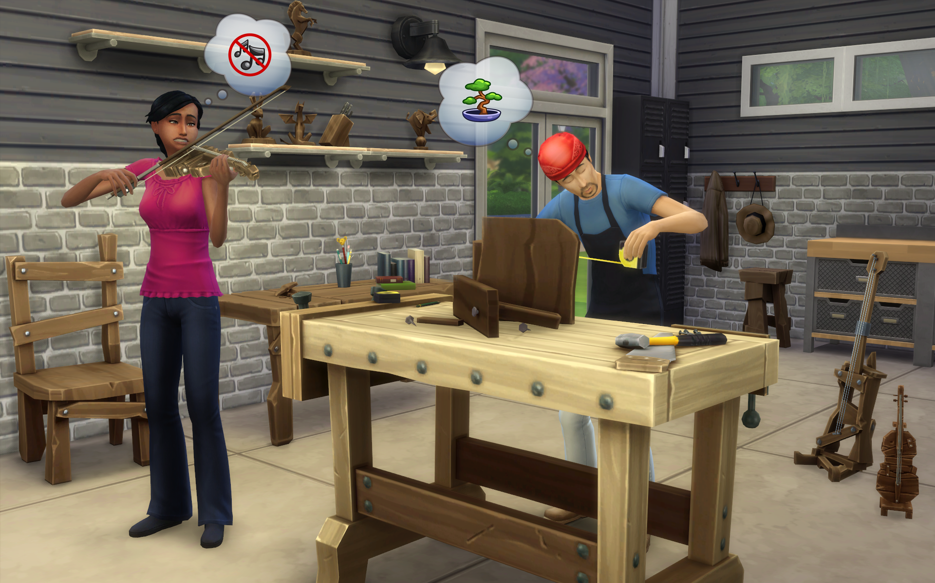
Notes:
These are components that are visualized within the game world but are not part of the game.
Common examples of this type of interface element include emoticons above the heads of the SIMs, floating player names in WoW, or even the beautiful topographical information displayed in Forza 4.

Slide 19
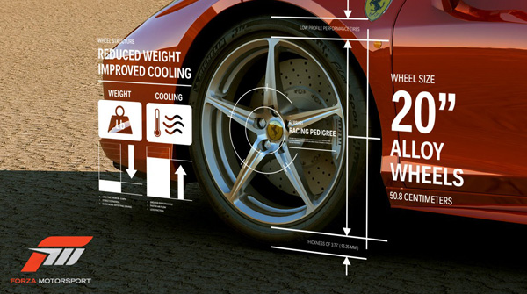
Notes:
These are components that are visualized within the game world but are not part of the game.
Common examples of this type of interface element include emoticons above the heads of the SIMs, floating player names in WoW, or even the beautiful topographical information displayed in Forza 4.

Slide 20
Spatial
Strengths
Weakness
Keeps the user immersed in the world and the task at hand
Can display abstracted data in world space
Satisfying to look at
Displaying a lot of information at once (limited space since its displayed in world space)
Depending on angle, can be partially obscured by objects in game world
Can be time consuming to make fit into 3D space when mapping against physical objects
Notes:
Keeps the user immersed in the world and generally focused on the task at hand. They can be very satisfying to look at.
Not so good at conveying a ton of information since it’s a virtual projection in world space rather than screen space. Depending on the angle a spatial element is being viewed at and other obstructions in front of the player and the element, spatial components can run into readability issues unless carefully controlled.

Slide 21
Notes:
And finally, Meta

Slide 22
Notes:
Meta components, we answer our two questions as follows:
Is the interface component in the game story? YES
Is the component in the game space? NO

Slide 23
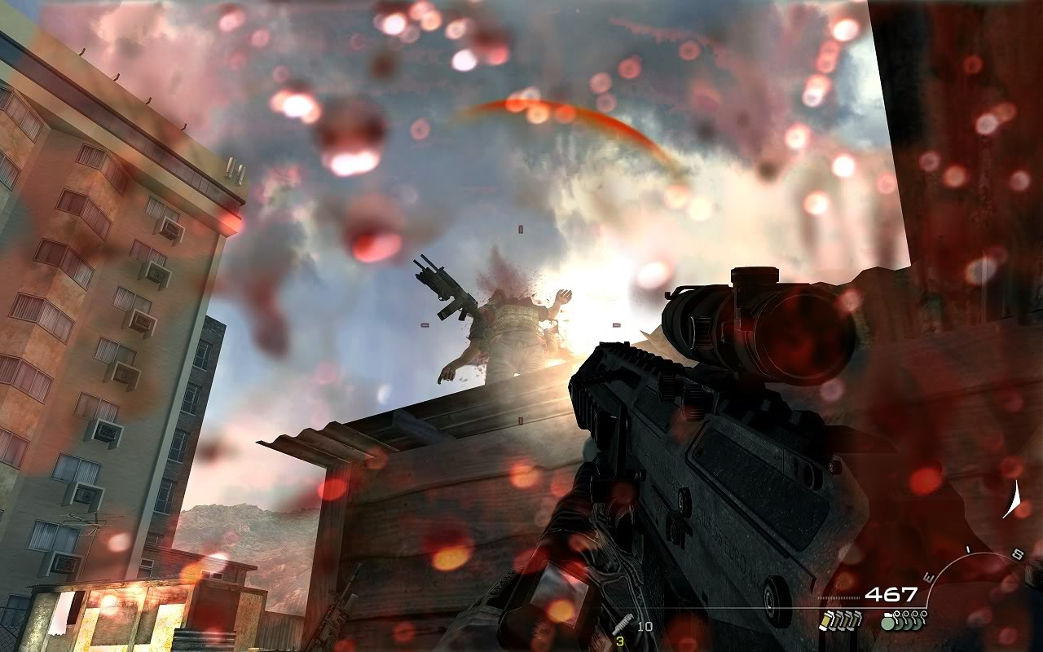
Notes:
These can be effects that are rendered onto the screen such as cracked glass and blood splatters – effects that interact with the fourth wall are the most common examples.
These components aim to draw the user into the reality of the game by applying cues to the screen as if the game were directly interacting with the player.
An example of this is the blood splatter on the screen used in Killzone

Slide 24
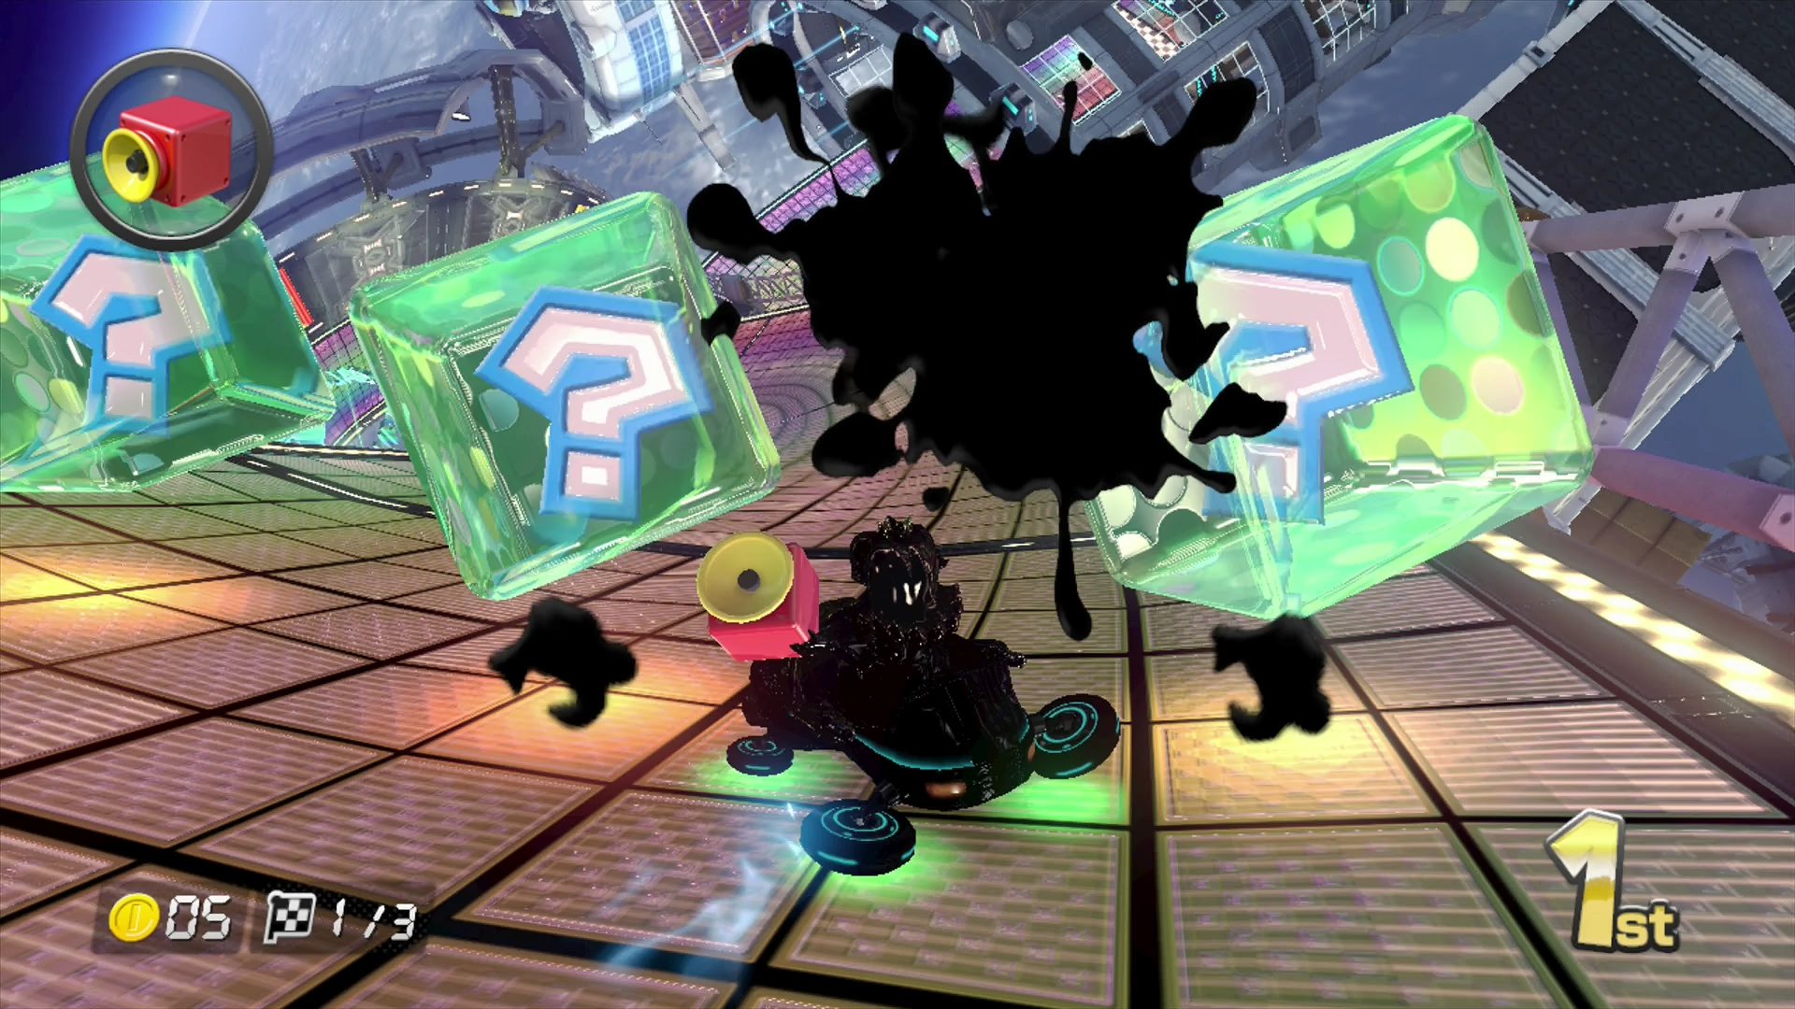
Notes:
or the ink splatter in Mario Kart .

Slide 25
Meta
Strengths
Weakness
Creating immersion without getting in the way too much
Displaying secondary information without taking up dedicated screen real-estate
Displaying lots of information or important data
Needs to be themed to really make any sense. Cant design an entire game around it
Notes:
What Meta is good at – creating immersion without getting in the way. Not good at conveying lots of information. Meta is frequently an accent piece in game UI design to create singular emotions but not necessarily to communicate lots of information.

Slide 26
Which one is best?
Notes:
So after all that, which one is best? The answer is:

Slide 27
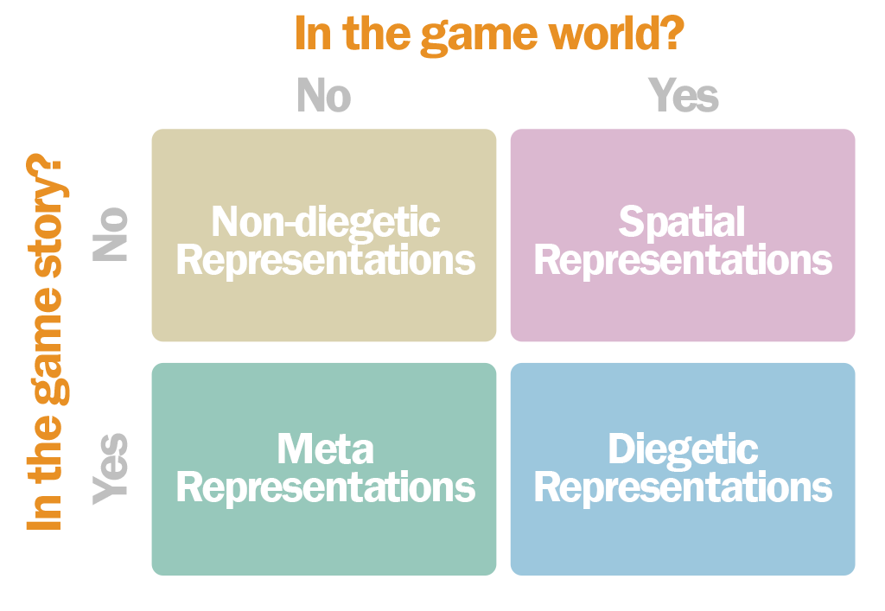
Which one is best?
Notes:
Complicated. No one component is the single winning method to follow in game UI design

Slide 28
Interface Design Loop
List Key Functionality
Map to UI Component
Review/Revise
Desired Emotional Response
Notes:
To reiterate what I said earlier, the important thing is knowing the strengths and weaknesses of each in order to target your goals more effectively.
The key task of any UI designer is to ask themselves:
What do I want my user to feel when they play the role of whatever virtual avatar the game is about.
Then create a list of all the functionality they will need from their UI.
Next, simply map your must-have functionality to various UI components I’ve just described (diegetic, meta, etc).
Finally, you review by testing your user’s emotional experiences when using those functions. If they aren’t experiencing your targeted emotional experience, rework the way you are displaying them until they do.

Slide 29
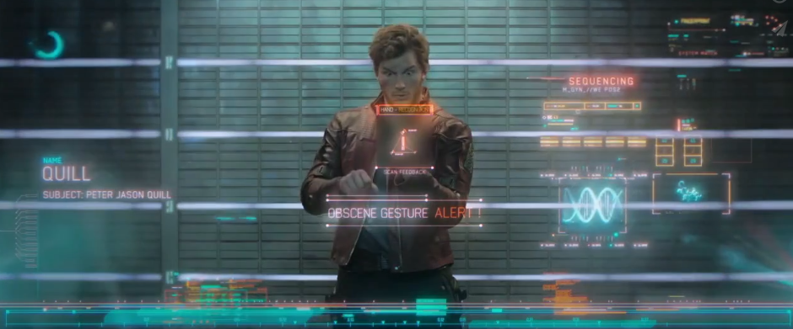
AR, meet Narrative
Notes:
Hopefully this explanation made you think about new ways to display information to your users.
When you use an AR device, you are literally looking through a screen into an environment which you then interact with.
The only thing that separates the real world from an FPS is a defined narrative which communicated back with the HUD.
If you’re not already thinking this way, I would challenge you to think about ways to add a narrative experience into your designs. I think you’ll find it to be a rewarding experience.

Slide 30
Notes:
Onboarding and managing complicated data-sets:

Slide 31
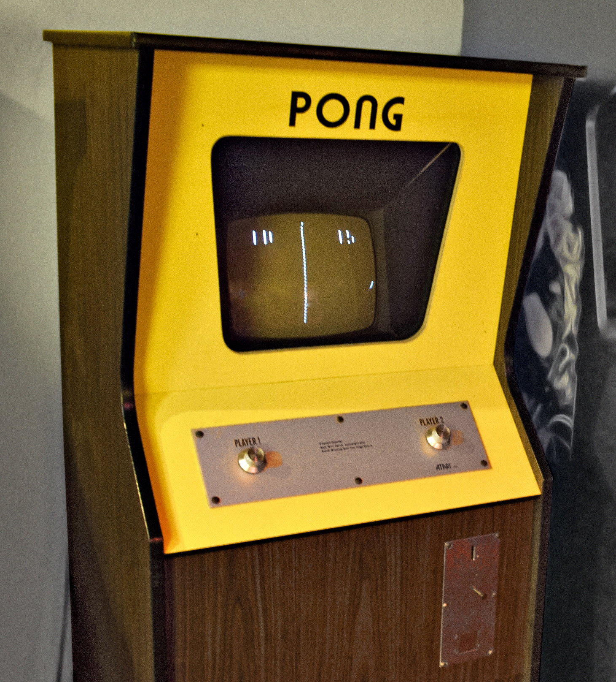
A brief history
Notes:
When games first came out, due to technological constraints, they were exceedingly simple.
Pong for instance is a great example of simplicity. The game featured 2 radial dials, a single coin input, 2 paddles, a ball, a net and score counters.
It cost the designer Allan Alcorn a little over $75 to construct the first prototype.
The gameplay and onboarding process, by the very nature of the games construction was simple.
Due to the lack of sophisticated controls and user interface layers, the user couldn’t help but almost intuitively understand how to play the game.
Simplicity = FUN

Slide 32
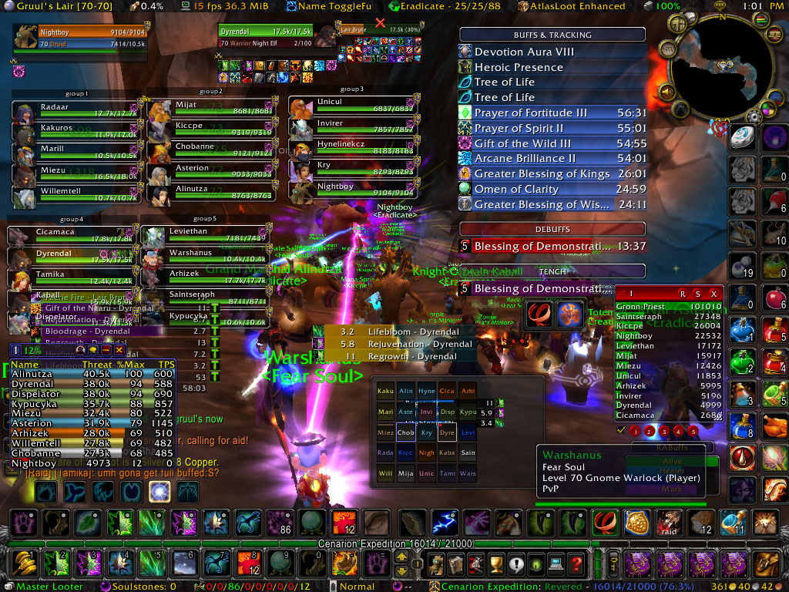
Fast Forward
Notes:
Now fast forward 40 years and you get a game like World of Warcraft.
Looking at a screen capture from this game and you would think that there is no way that the onboarding process could be an enjoyable or intuitive experience for a new user.
You’d expect it to be a frustrating user experience, yet at its peak, WoW had 12 million subscribers and, as I showed earlier, has earned over 10 Billion with a “B” dollars lifetime.
So what’s going on?

Slide 33
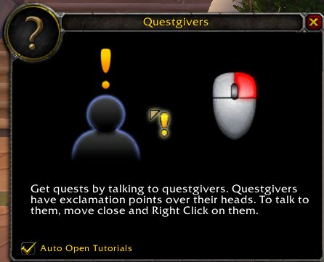
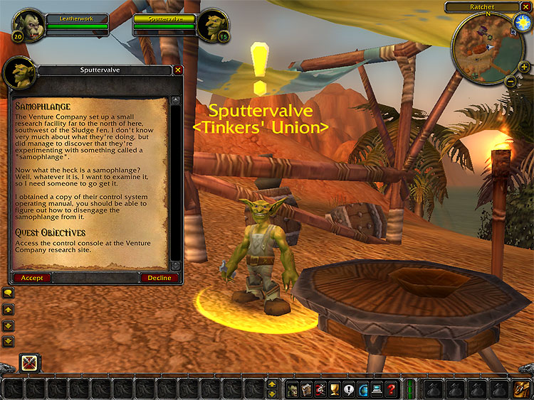
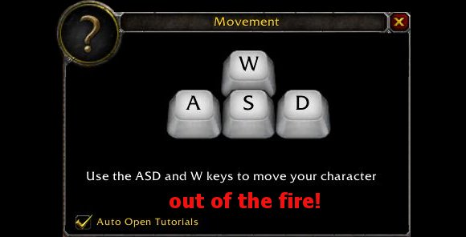
FTUE & Flow
Notes:
One of the keys to their success is the effective implementation of the principle of FLOW.
When entering their product for the first time at a novice level, you first encounter basic challenges that slowly introduce you to your universe and its mechanics.
As you complete quests, your Experience Points rise which, in turn, expose you to higher levels with greater challenges, unlocked functionality, and increasing difficulty.
Eventually, you are introduced to the full potential of the game with all its social interactions involving communities of players. But the developers were very careful not to scare their users away with complexity. Baby steps, but not hand holding are key.
The system WoW employs allows each player to stay in his or her individual flow zone.
Progress thorough the game is kept at their own pace rather than being pushed upon by the developer.
At the same time, challenges abound to keep new players feeling just as cognitively challenged as experienced ones. This in turn gives the game a perceived value above other products. Players continually feel challenged and learn from it no matter how much they use it. They feel they are getting good ROI.

Slide 34
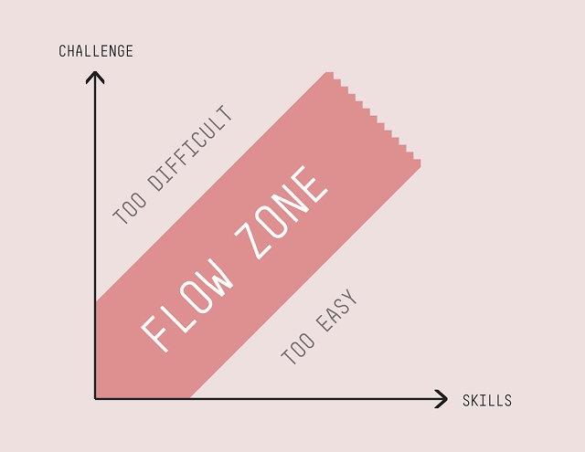
FTUE & Flow
Notes:
The challenge then is to look at any consumer facing product and ask yourself can you create a product that adapts responsively to the skills of its user?
If you were able to gradually introduce features and track progress of a user as they begin using those features, you would be taking a giant step forward to delivering something special.
Knowing when a user is ready to take on more information and advance deeper into your product is key towards delivering an engaging and rewarding experience for your consumer.

Slide 35
Closing Thoughts
Coloring inside the lines is for CHUMPS!
Coloring inside the lines is for CHUMPS!
Notes:
Finally, as I was working on this presentation, I kept coming back to a catch phrase of an old colleague of mine. I really wanted to work it in somehow.
He and his identical twin brother, who I also worked with at one point, developed this catch phrase when they were kids and I think it does a great job summing up what it takes to deliver on innovation in the creative and technical space. The phrase is:
Coloring inside the lines is for Chumps!
Be aggressive, take risks, and don’t be afraid to color outside the lines. It can make all the difference.

Slide 36
Notes:
Questions?

